Slide 1

Building a Remote Controlled Robo – Car
( Wired and Wireless )
By :
Mandeesh Singh ( T.S.G. Member )
6th Semester , ECE

Slide 2
AIM ( What ? )
Learning the Basics of Robotics
Learning about Components & Basics parts of a Robot
Making Efficient & Effective Working Robots ( Manual )

Slide 3
PURPOSE ( Why ? )
Knowledge
Interest / Hobby
Competitions / Prizes
→ Cash / Goodies
→ Certificates
→ Participative Spirit & Learning Curve

Slide 4
Types of Competitions
Robo GP / Robo Race (Most Common)
→ Variants : Aqua wars , Robo Soccer , etc.
Robo Wars
Line Follower ( Line Following Robot )
Micromouse ( Advanced ) , etc.

Slide 5
Basic Requirements
A Team of 4
Soldering Iron , Solder , flux , Holder
Multimeter , Extra Leads ( Optional )
Wire Cutter , Wire Stripper
Line Tester , Screw Driver ( Kit – Optional )
Insulation Tape
General Purpose P.C.B.

Slide 6
Breadboard
Connecting Wires
  →Single Core Hard Wire ( For Breadboard )
  → Thin Wire ( For Connections on G.P. P.C.B. )
  Enthusiasm & Dedication Would be Self Beneficial & Appreciated

Slide 7
Robot : What is it ?
Technically , A Reprogrammable multifunctional manipulative electromechanical design to move materials , parts for the performance of a variety of Tasks.
Autonomous
Based on Artificial Intelligence

Slide 8
Types
Wired
Wireless
Pre-Programmed
Autonomous (Intelligence Integrated)

Slide 9
Basic Construction : Robot
Mechanical System
Power Supply
Actuators ( Motors , Hydraulics , Pneumatics , etc. )
Sensors : Programmable Robots
Controllers ( Switches , P.C. , Mobiles , Microcontrollers , Speech , etc )

Slide 10
Mechanical System
Deals with Mechanical Aspects
Includes : Chassis ( Basic Body Skeleton ) , Wheels , Placements ( Nuts , Screws , Bolts , Misc. articles )

Slide 11
Wheel Locomotion
Movement & Turning of Wheels
Differential Type
Car Type
Synchronous Type

Slide 12
Power Supply
Powers the Robot
Types : D.C. Battery ( Rechargeable / Non Rechargeable )
Adapters ( Requires A.C. Supply )
*Self Made Supply : Using Transformer , Diodes , Voltage Regulators , Filter Capacitors , Resitors , etc

Slide 13
Actuators
Converts Electrical input to Mechanical Output
Mechanical O/P : Linear / Rotatory
Most Common : Electric Motors

Slide 14
Motors
AC
Stepper : For Controlled Movement
DC : Used Commonly
Servo : DC Motors with Internal feedback & Error Compensation

Slide 15
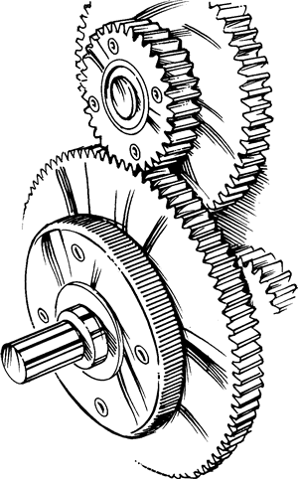
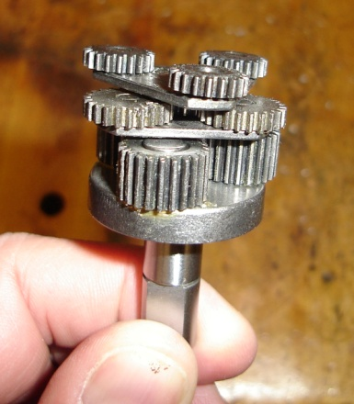
D.C. Motor : Geared
Gears : Reduces Speed (r.p.m.) but improves Torque & Power
Therefore , Geared D.C. Motors can Carry Heavier Loads.

Slide 16
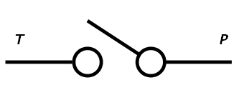
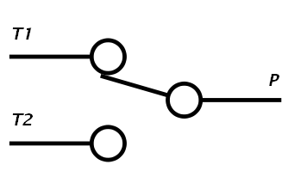
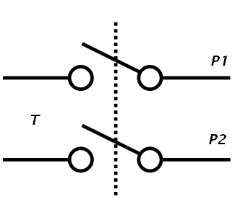
Controllers : Switches
Types : SPST , SPDT , DPST , DPDT
SPST :
SPDT :
DPST :

Slide 17
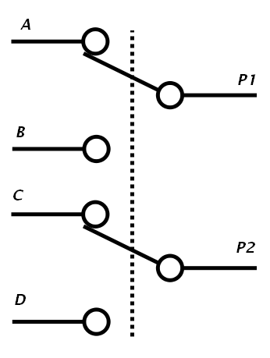
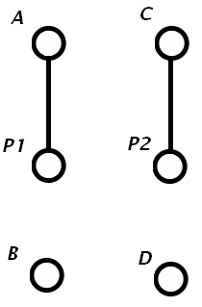
DPDT :

Slide 18
Wired R.C. Car : Requirements
4 * D.C. Geared Motors ( 6 – 24 Volts , 150 – 300 r.p.m. )
Power Supply : 6V/4.5 Ah or 12 V/7.2 Ah D.C. battery or Adapter , Self Made Supply etc.
1 * Bakelite Sheet/Thin Wooden Plank/Thin Plastic Sheet, etc ( <= 25*25 cms )

Slide 19
4* Wheels ( Buy Extra for Convenience )
10 colored Ribbon Wire – 5 mtrs
4* 1.25 inch Clamps
2* DPDT Switches
1* G.P. P.C.B.
1 Pack of Nuts, Bolts ( Size : Similar to holes in Clamps , 8 each required)
Soldering Iron , Solder , Flux , Holder

Slide 20
Construction
Take the Bakelite Sheet & Drill Holes according to Placement of motors and in symmetry with each other.
Clamp the 4 Motors with the Sheet.
Solder the Terminals ( Positive and Negative ) of each motor with wires from Ribbon Wire. ( Net : 4*2 Wires )
Short the Common Polarity Wires of each side ( Net : 4 Wires , L & R : +ve & -ve each)

Slide 21
Now there are 4 Wires , 2 each ( +ve and –ve ) from Left Motors & Right Motors.

Slide 22
Switching Action ( Imp )
Using 2* DPDT switches / 4* Push to ON Switches.
Use Multimeter to Understand the functionality of switches.
Be Careful while Soldering wires and periodically check for Correctness.

